Slide 1

Robot Obstacle avoidance with reinforcement learning
Group Members:
Alexandre Dietrich
Ankur Tyagi
Haitham Alamri
Rodolfo Vasconcelos
Intelligent Systems and Reinforcement Learning

Slide 2
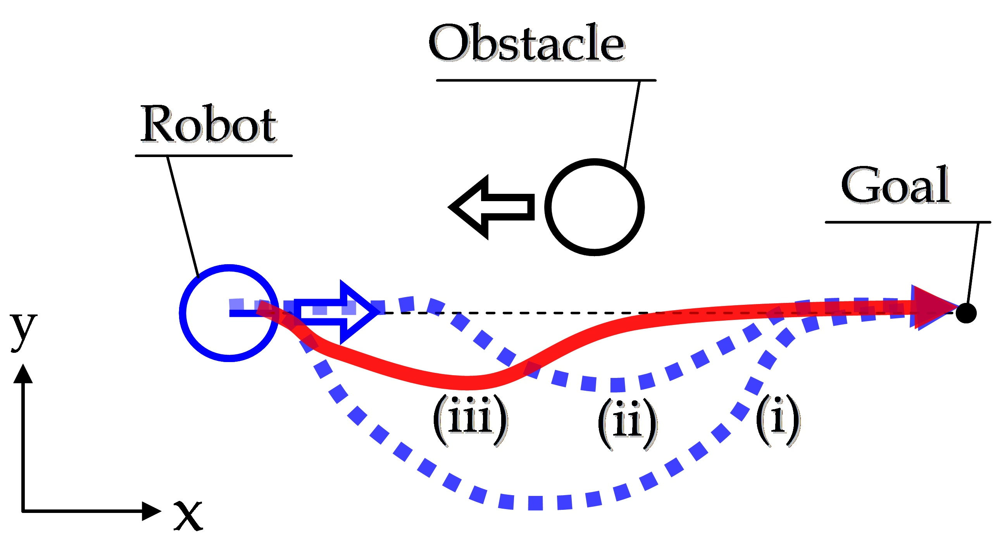
Problem Statement
Find the optimal path for robot to reach an end point (goal state) while avoiding randomly generated obstacles in a 2D space
Reference : https://bayesianadventures.wordpress.com/2015/08/31/obstacle-avoidance-for-clever-robots/

Slide 3
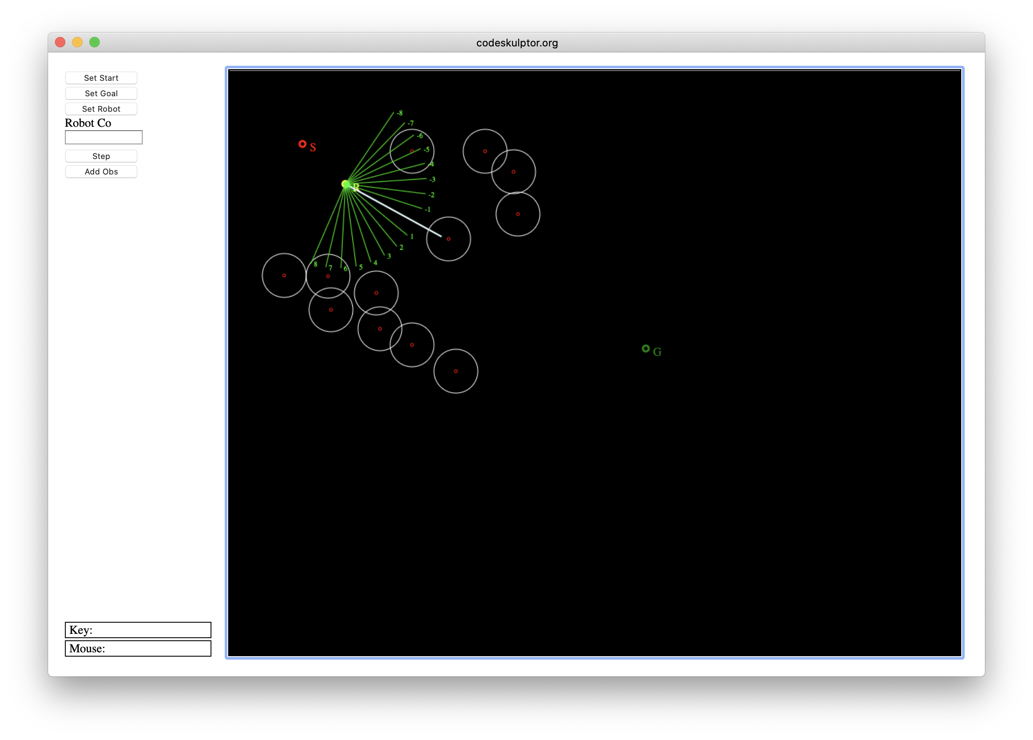
Background
Original Environment simulation created on codeskulptor
How to play :
Choose the staring point of the robot
Choose the goal
Define obstacles
Navigate the path using the step and avoid any incoming obstacles while navigating towards the target state.
Prerequisite for setup:
Converted codeskulptor to run on python3 in local environment
Understand the Bayesian working of the module.

Slide 4
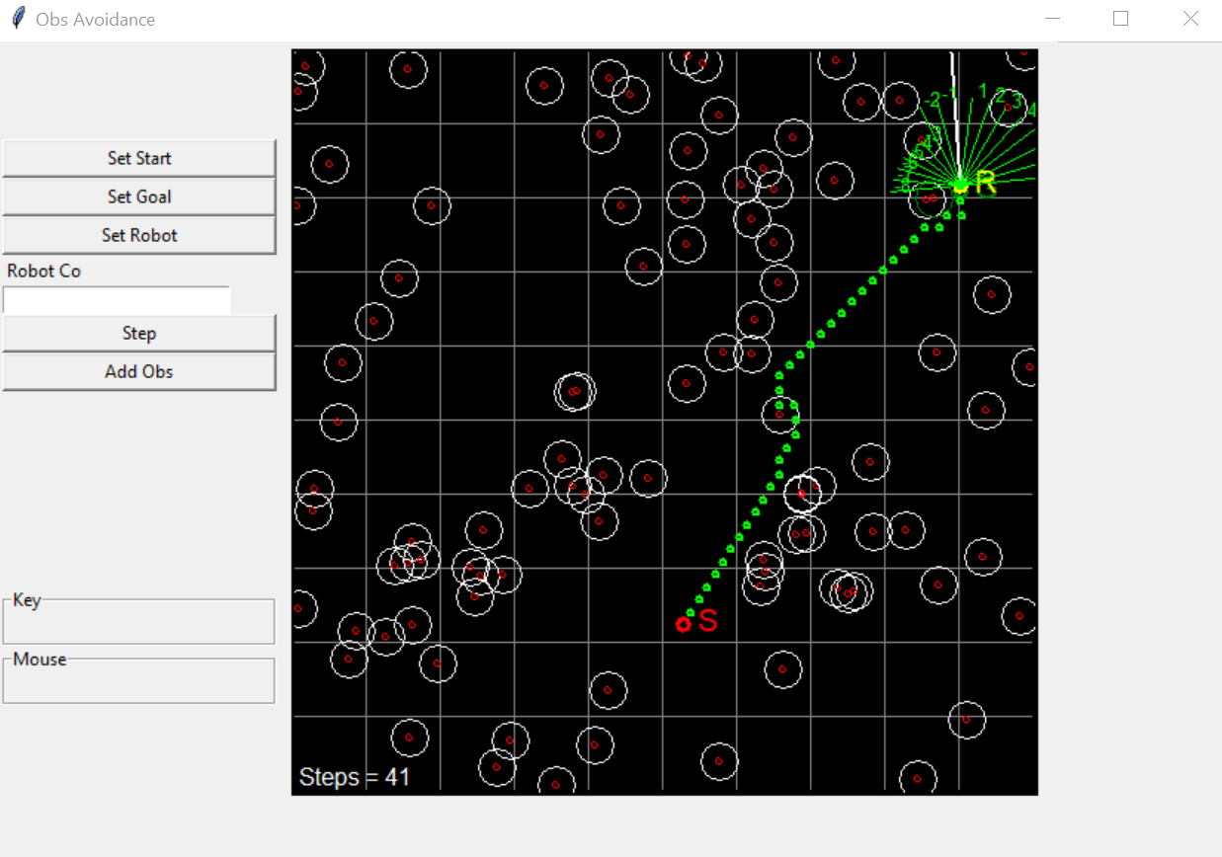
Approach - 1
Assumptions:
500*500 pixels Starting point : top corner(10,10) End point : bottom right corner (450, 450) Actions(s): Up, Down, Right and left States: all possible states within a 4 x 4 grid with 0, 1 or 2 obstacles | T(s'|s; a): probability of s0 if take action a in state s = 1 (No uncertainty) Reward(s; a; s0): -1 without obsctacle, -5 when there is an obstacle Discount factor = 0.6
Sample policy : policy_key=(3, 0)|[]
---------------------------
-1.00|-1.00|-1.00|-1.00|
---------------------------
-1.00|-1.00|-1.00|-1.00|
---------------------------
-1.00|-1.00|-1.00|-1.00|
---------------------------
0.00|-1.00|-1.00|-1.00|

Slide 5
Approach - 2
500*500 pixels Starting point : top corner(10,10) End point : bottom right corner (450, 450) Actions(s): Up, Down, Right and left States: all possible states within a 4 x 4 grid with 0, 1 or 2 obstacles | T(s'|s; a): probability of s0 if take action a in state s = 1 (No uncertainty) Reward(s; a; s0): -1 without obsctacle, -5 when there is an obstacle Discount factor = 0.6
Find the optimal path for robot to reach an end point (goal state) while avoiding randomly generated obstacles in a 2D space

Slide 6
Conclusion
Find the optimal path for robot to reach an end point (goal state) while avoiding randomly generated obstacles in a 2D space

